Slide 1
Class of 1969 50 Year Reunion, October 18-20, 2019
Douglas MacArthur High School
In Memory of our fellow Brahmas

Slide 2
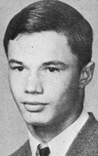
Doug
Andrew

Slide 3
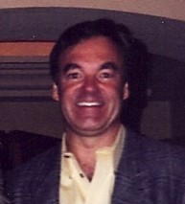
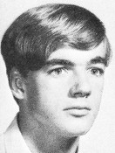
BILL
ASH

Slide 4
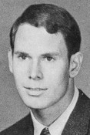
STEVE
BECK

Slide 5
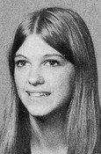
SUZIE
BECK

Slide 6
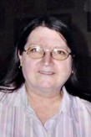
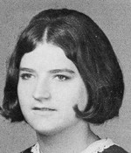
LINDA
BENZING (JONES)

Slide 7
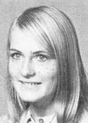
JANINE
BLAIR

Slide 8
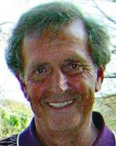
JIM
BOLDT

Slide 9
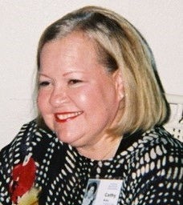
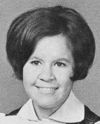
CATHY
BRALY

Slide 10
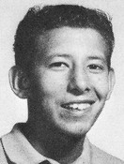
ROBERT
CARRANZA

Slide 11
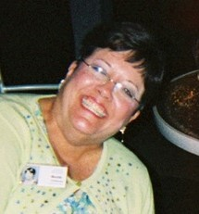
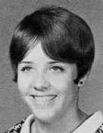
BETH CHILDRESS

Slide 12
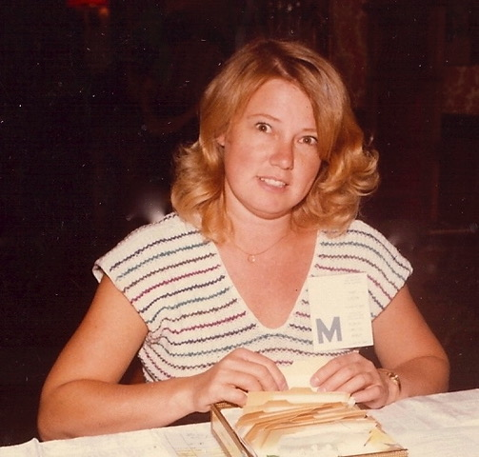
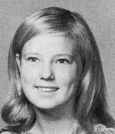
SANDY CLOPTON
(POTTER-JOHNSON)

Slide 13
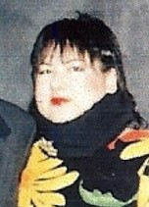
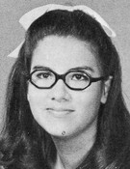
DENISE CONTRERAS (SERAFIN)

Slide 14
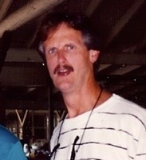
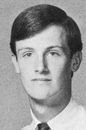
TONY DEGGES

Slide 15
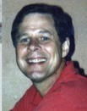
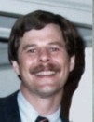
GREGG DEHONEY

Slide 16
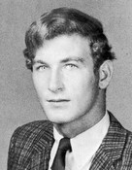
CRAIG DEVINE

Slide 17
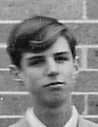
GARY ENGLEMAN

Slide 18
LEROY ERNEST

Slide 19
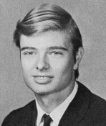
RUDAN FORKEY

Slide 20
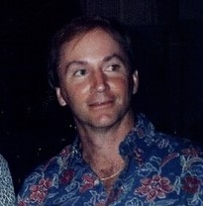
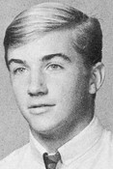
CHARLIE
GARRETT

Slide 21
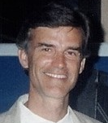
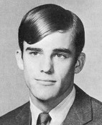
JOE
GRAHAM

Slide 22
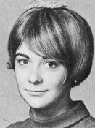
MOLLIE GUTHRIE
(MONTANIO)

Slide 23
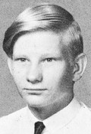
STEVE
IVANOSKI

Slide 24
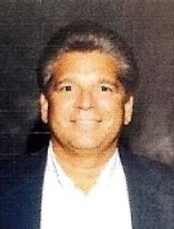
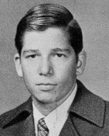
MARK
KARPEL

Slide 25
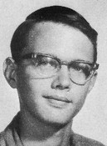
TIMOTHY
KAYSER

Slide 26
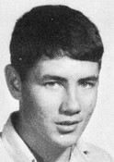
JIM
KERLEY

Slide 27
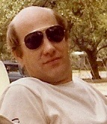
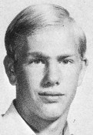
FRITZ
KNUST

Slide 28
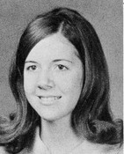
JANET KOEHLER
(KROLAK)

Slide 29
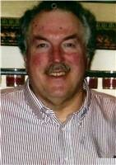
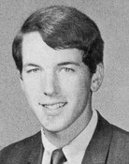
TERRY
KOHUTEK

Slide 30
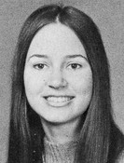
LYNNE
LEWIS

Slide 31
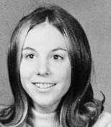
NANCY MARTIN
(KRSZJZANIEK)

Slide 32
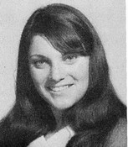
DAWN
McINTIRE

Slide 33
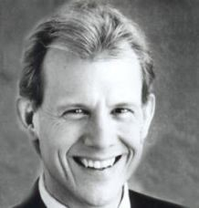
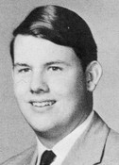
DAN
MEADOR

Slide 34
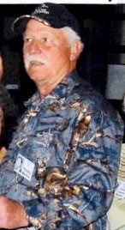
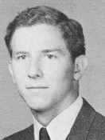
RANDY
MERKIN

Slide 35
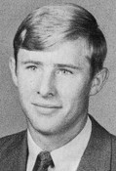
DOUG
OLS0N

Slide 36
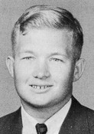
FRED
PITZKE

Slide 37
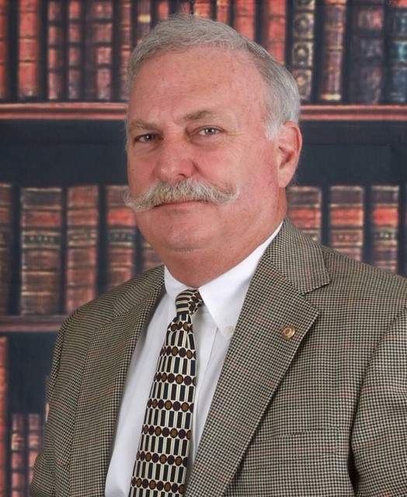
JIMMY SCHWIND

Slide 38
STEPHANIE SIEBERT

Slide 39
CHESTER
SLIMP

Slide 40
TOM
SNYDER

Slide 41
SCOTT
SPENCER

Slide 42
MICHELLE
STRICKLAND

Slide 43
ROGER
TEAGARDEN

Slide 44
JOAN TOWER
(HART)

Slide 45
CAROLYN WALKER
(RODRIGUEZ)

Slide 46
VICKIE WILLARD
(PATTERSON)

Slide 47
BECKY
WILSON

Slide 48
BILL
ZERBE

Slide 49
Class of 1969 50 Year Reunion, October 18-20, 2019
Douglas MacArthur High School
In Memory of our fellow Brahmas

